Slide 1
Matplotlib
Programming for Data Analytics
Andrew.Beatty@atu.ie

Slide 2
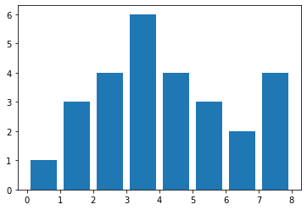
Remember how to Make a plot
import matplotlib.pyplot as plt
# make data:
x = [0.5,1.5,2.5,3.5,4.5,5.5,6.5,7.5]
y = [4.8, 5.5, 3.5, 4.6, 6.5, 6.6, 2.6, 3.0]
# plot
fig, ax = plt.subplots()
ax.bar(x, y)
plt.show()

Slide 3
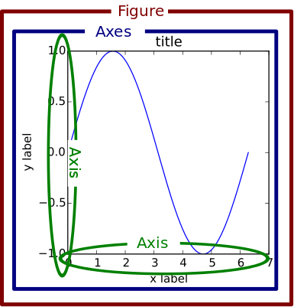
Under the hood it is Object oriented
Figure contains
Axes which contain
Axis

Slide 4
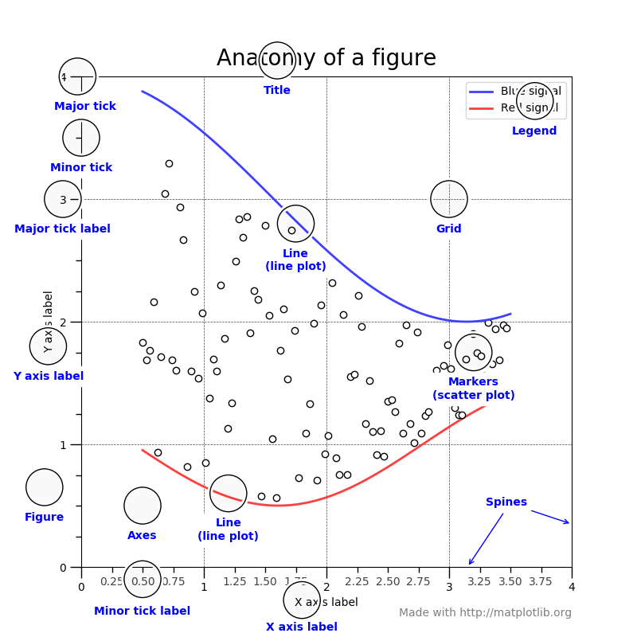

Slide 5
Code for that
showcase example code: anatomy.py — Matplotlib 2.0.2 documentation

Slide 6
Time for a Cuppa of your favourite brew

